Slide 1
SURVEILLANCE SENTRY LIGHT
MENTOR : Dr. A.RAMATHILAGAM M.E., Ph. D.,
TEAM MEMBER 1 :VIGNESH ABRANANTHAM T.
TEAM MEMBER 2 : M.SURESH KUMAR.
TEAM MEMBER 3 : B.PRAKASH.

Slide 2
OBJECTIVES:
To reduce the consumption of the power.
To achieve the safety of the house during night times.
To achieve the cost effectiveness and to give more worth full product.
Provide real-time alerts like Send notifications to users' smartphones or other devices when motion is detected.

Slide 3
ABSTRACT:
The proposed mini project entails the development of a motion sensor light system designed to illuminate upon detecting motion during nighttime hours, thus conserving energy and enhancing security.

Slide 4
LITERATURE SURVEY:
Serial Number | Year Published | Title | Author | summary
1. | (November-2021) | Review of Motion Sensors as a Home Security System and approach to the Internet of Things Project. | Yandri Lesmana | Home security motion sensors: accurate, cost-effective, integrate with smart homes, trigger actions like lighting control and smartphone alerts.
2. | (October-2022) | Sensor Technology Advances and Future Trends. | Olfa Kanoun | Better accuracy, smaller size, energy efficiency. Future: AI integration, connectivity boost, wider healthcare and environmental uses.

Slide 5
LITERATURE SURVEY:
Serial Number | Year Published | Title | Author | Summary
3. | (October-2021) | Evaluation of energy-efficiency in lighting systems using sensor networks. | Declan T Delaney | LightWiSe, a Wireless Sensor Network tool, evaluates and optimizes existing lighting control systems in modern buildings, identifying energy wastage areas and suggesting improvements, potentially achieving savings of 50% to 70%.

Slide 6
LITERATURE SURVEY:
ADAVNTAGES OF THESE SURVEY:
Energy efficiency.
Cost-effectiveness.
DISADVANTAGES OF THE SURVEY:
False alarms.
Limited detection range.
Dependency on power source.

Slide 7
PROPOSED SYSTEM:
Basic Motion Sensors:
Typically employing passive infrared (PIR) sensors, the existing motion sensor light systems detect changes in infrared radiation emitted by moving objects within their detection range.
Automatic Detection Camera:
An automatic detection camera is a type of surveillance camera equipped with advanced detection capabilities that enable it to automatically identify and track objects, people, or events of interest within its field of view.

Slide 8
PROPOSED SYSTEM
ADVANTAGES PROVIDED MY OUR SYSTEM:
False alarms:
To solve the false alarms which was given in the old sensors like detecting the pet animals .
Limited detection range:
To solve the range problems.
Dependency on power source:
If the power source fails or is interrupted, the sensor may not function properly.
So in this system the sensors will works properly.

Slide 9
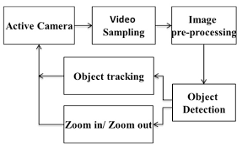
FUNCTIONAL DIAGRAM FOR (DETECTION CAMERA):

Slide 10
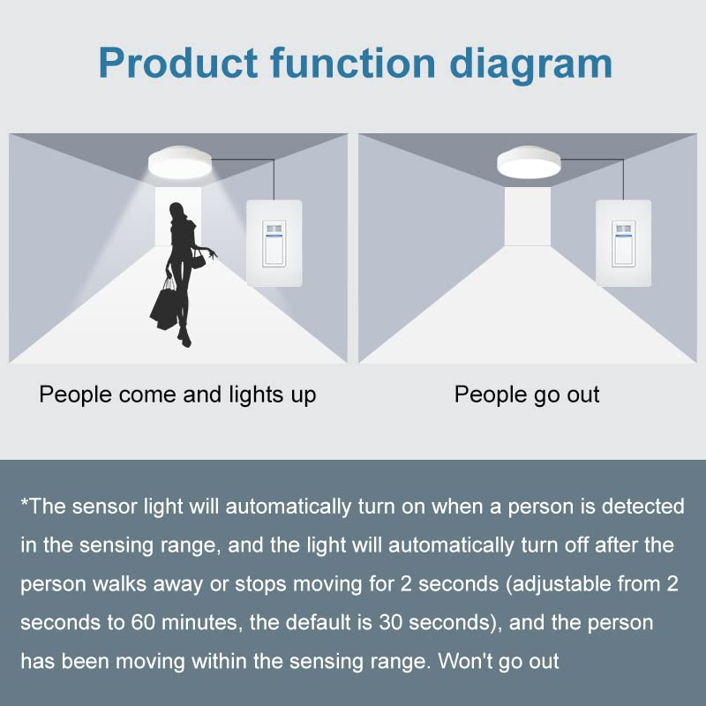
FUNCTIONAL DIAGRAM FOR (MOTION SENSOR LIGHT):

Slide 11
MODULES DESCRIPTION / IMPLEMENTATION METHODOLOGY:
Motion sensor lights typically consist of:
Motion Sensor: Detects movement using technologies like PIR, microwave, or ultrasonic sensors.
Light Fixture: Holds the light source (usually LED) and integrates the motion sensor.
Power Source: Wired into the electrical system or powered.
Adjustment Controls: Allow customization of sensitivity, duration, and sometimes direction.

Slide 12
MODULES DESCRIPTION / IMPLEMENTATION METHODOLOGY:
Detection camera typically include:
Camera Lens: Captures visual information.
Image Sensor: Converts optical images into electronic signals.
Processing Unit: Handles image processing and encoding.
Memory Storage: Stores recorded footage.
Power Source: Wired.
Connectivity: Wired or wireless communication.
Motion Detection Sensors: Triggers recording/alerts.
IR Illuminators: Enables night vision.
User Interface: Configures settings and views footage.

Slide 13
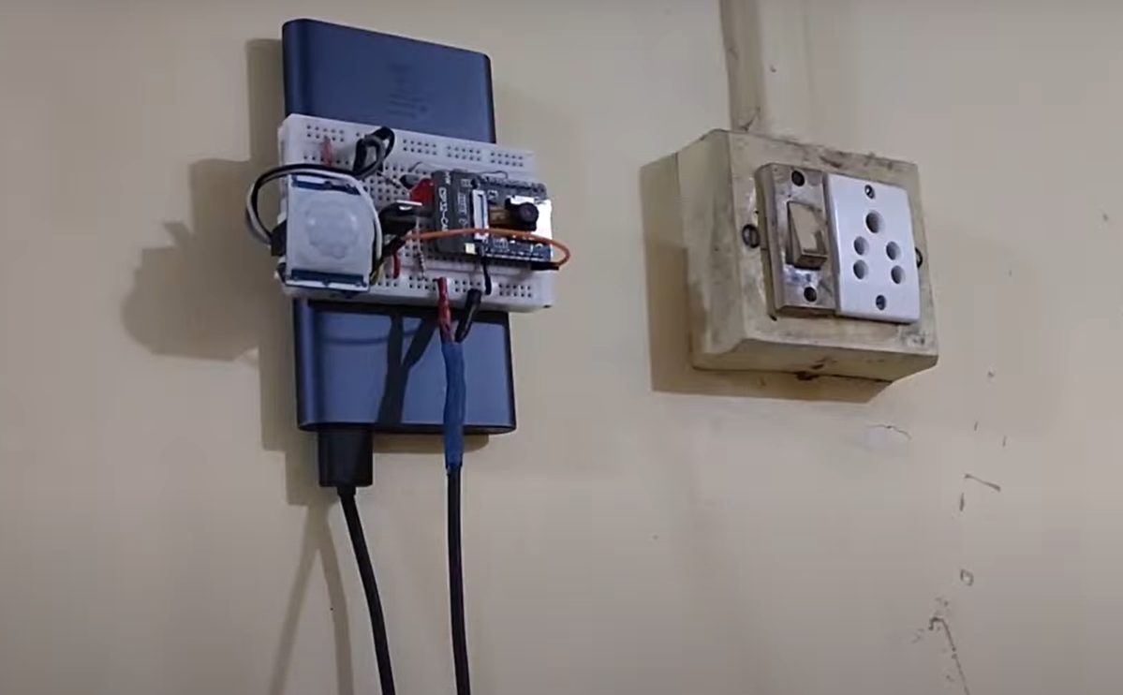
SAMPLE OUTPUTS\SCREEN SHOTS:

Slide 14
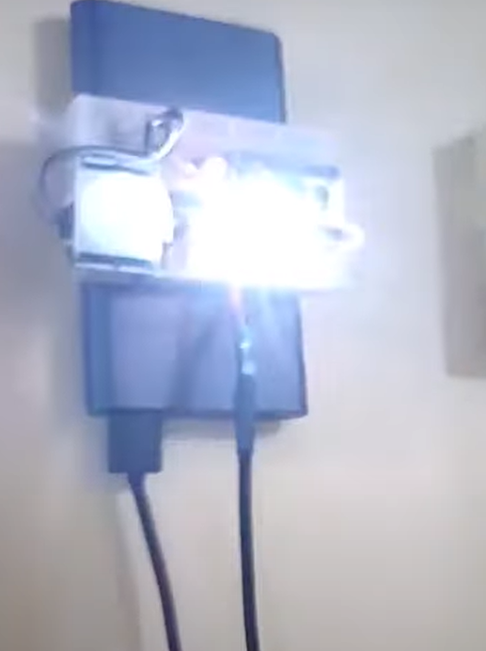
SAMPLE OUTPUTS\SCREEN SHOTS:

Slide 15
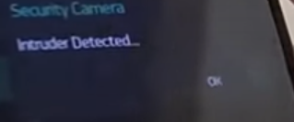
SAMPLE OUTPUTS\SCREEN SHOTS:

Slide 16
REFERENCE:
Review of Motion Sensors as a Home Security System and approach to the Internet of Things Project(November-2021).
Advances in Motion Sensor Technology: A Comprehensive Survey(October-2022).
A Review on Motion Sensor-Based Security Systems(November-2021).
Energy Efficiency Improvement with Motion Sensor Lighting Systems(October-2021).

Slide 17
THANK YOU

